Slide 1
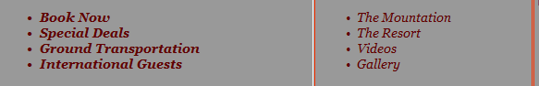
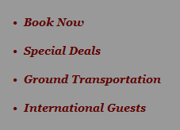
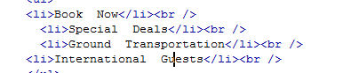
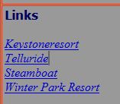
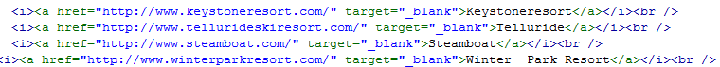
Web Authoring (Ski Resort Task)
Task 6 – HTML Tags
1. Insert a line break after each bullet point in the columns shown below. Look at the difference between the before and after screen shots.
2. Apply the italic tag to the hyperlinks. 3. Also Apply the line break tag so links are on separate lines.
Before
After
Code View

Slide 2
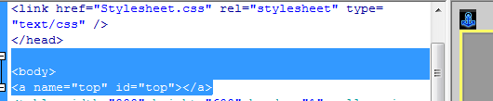
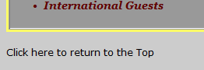
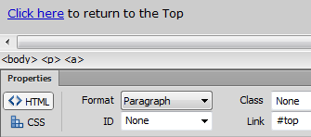
Web Authoring (Ski Resort Task)
Task 6 – Named Anchor
1. Insert a named anchor called Top just after the Body Tag. If you insert the named anchor just after the body tag then the anchor will be place at the top of the webpage. 2. Write the text “Click here to return to the Top” 3. Link the word “Click here” to the Top Named Anchor
Tip: A named anchor will link you to a specific part of the current webpage. For example if you want to return to the top of the page.
Tip: To link to an anchor you need to type #Name of Anchor

